Slide 1
Capstone Project: Fraud Detection Model Deployment
Business Analytics Project-
A Case Study of PayPal
Presented by: Chukwuemeka Vincent
Date: 27th April 2025.
Notes:
Welcome everyone. Today, I’ll be presenting my capstone final project where I developed and deployed a fraud detection model. I used Paysim simulated dataset that mimics PayPal real-life financial transactions. Lets delve into the project overview.

Slide 2
Project Overview
Objective: Detect fraudulent transactions using machine learning.
Approach: Data analysis → Modeling → Deployment.
Deployment: GitHub →Flask App → Render.com → Live App
Notes:
The goal was to build a solution from exploratory data analysis through to live deployment. I decided to deploy my model on render.com due to it user friendly interface and free live deployment.

Slide 3
Dataset & Preprocessing
Dataset: Simulated transaction data.
Data Preprocessing:
- Handle missing values
- Feature scaling
- Encoding categorical variables
Notes:
The dataset simulated a real-world environment with missing and mixed data types. The dataset was cleaned, normalize or standardize using feature scaling, and label encoding to convert categorical variable into numerical values.

Slide 4
Exploratory Data Analysis (EDA)
- Severe class imbalance (<5% fraud cases) - Feature correlations - PCA for reduction
Notes:
EDA highlighted important factors influencing fraud like payment, cashout, cash-in and exposed class imbalance through the bar chart.

Slide 5
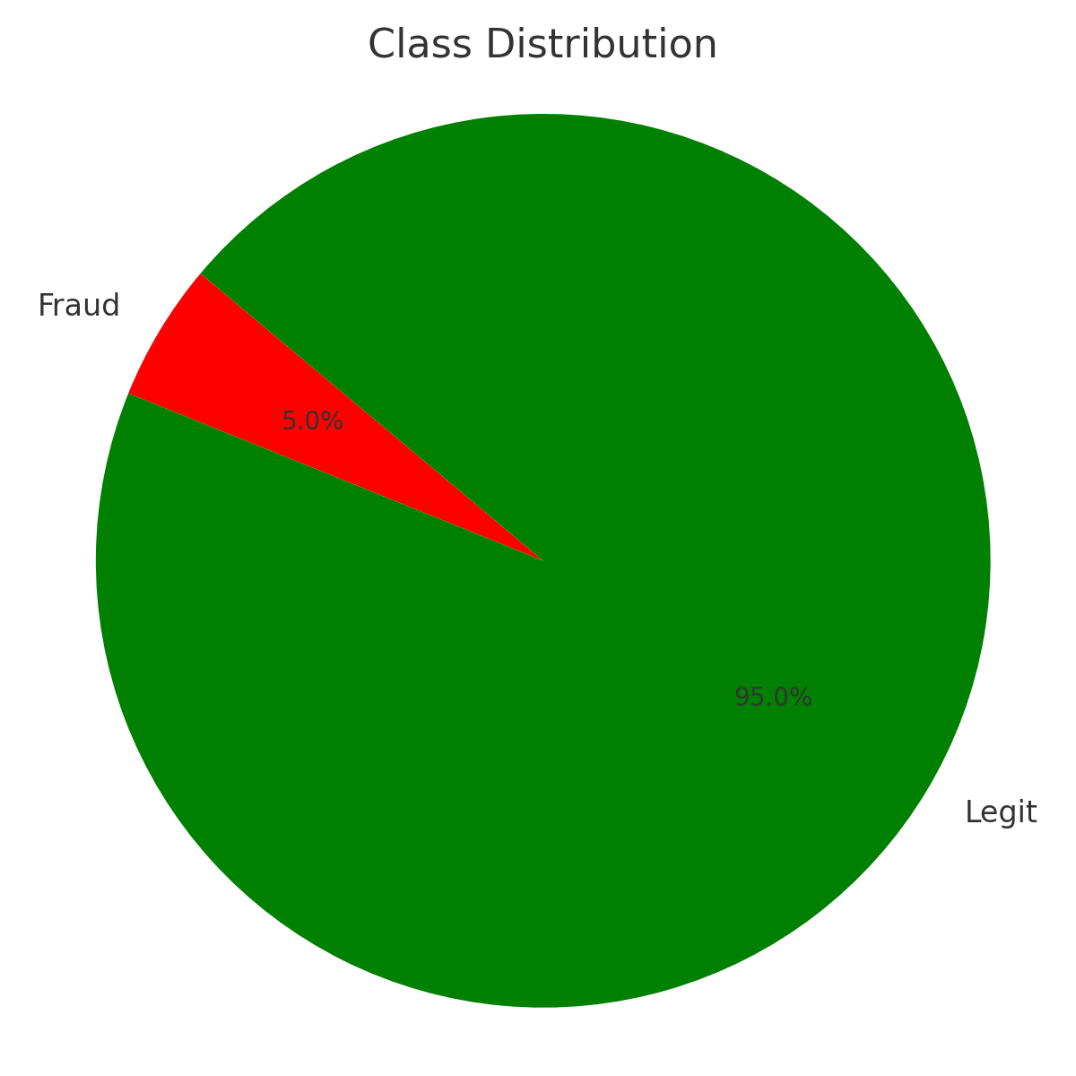
Class Distribution
Notes:
Class imbalance was a critical challenge that needed to be addressed. This necessitated the need for SMOTE to balance the data.

Slide 6
Model Development
Models: • Logistic Regression • XGBoost
Metrics: • Accuracy • Recall • F1-Score • AUC
Notes:
Multiple models were tested to ensure robustness, with focus on recall.

Slide 7
Model Evaluation
Best Model: XGBoost
Accuracy: 100%, Recall: 100%, Precision: 100%, AUC ROC 0.99(99%)
Feature importance and confusion matrix analysis
Notes:
XGBoost achieved strong performance and was chosen for deployment. Let’s see the next slide for the top 5 feature importance.

Slide 8
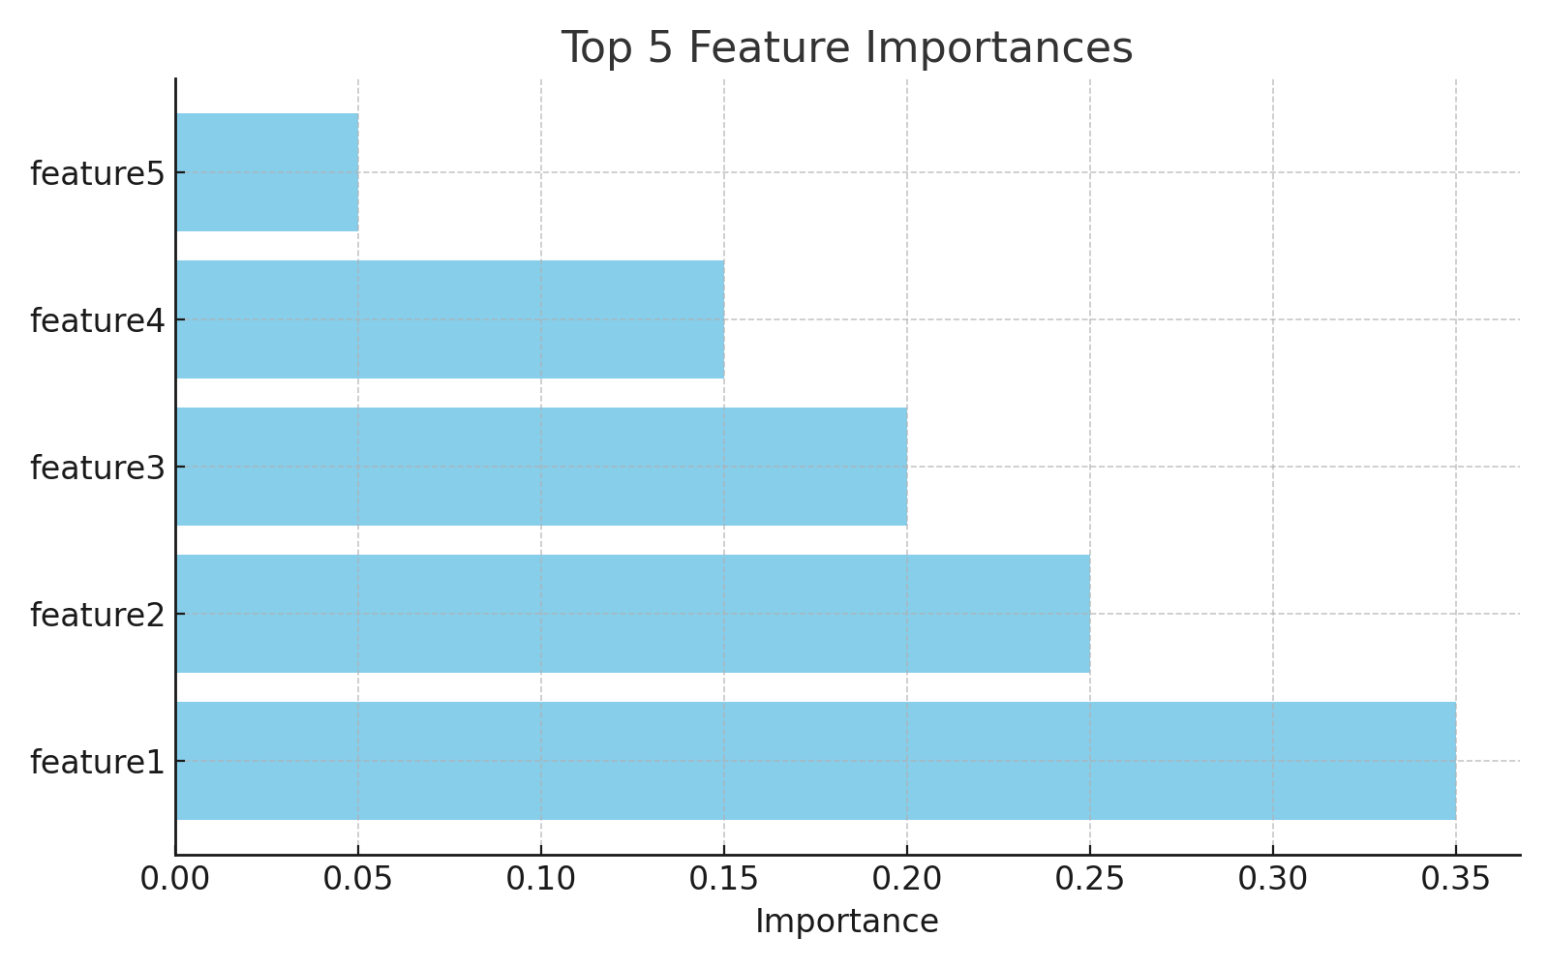
Feature Importance
Notes:
Feature importance shows the top predictors for fraud detection.

Slide 9
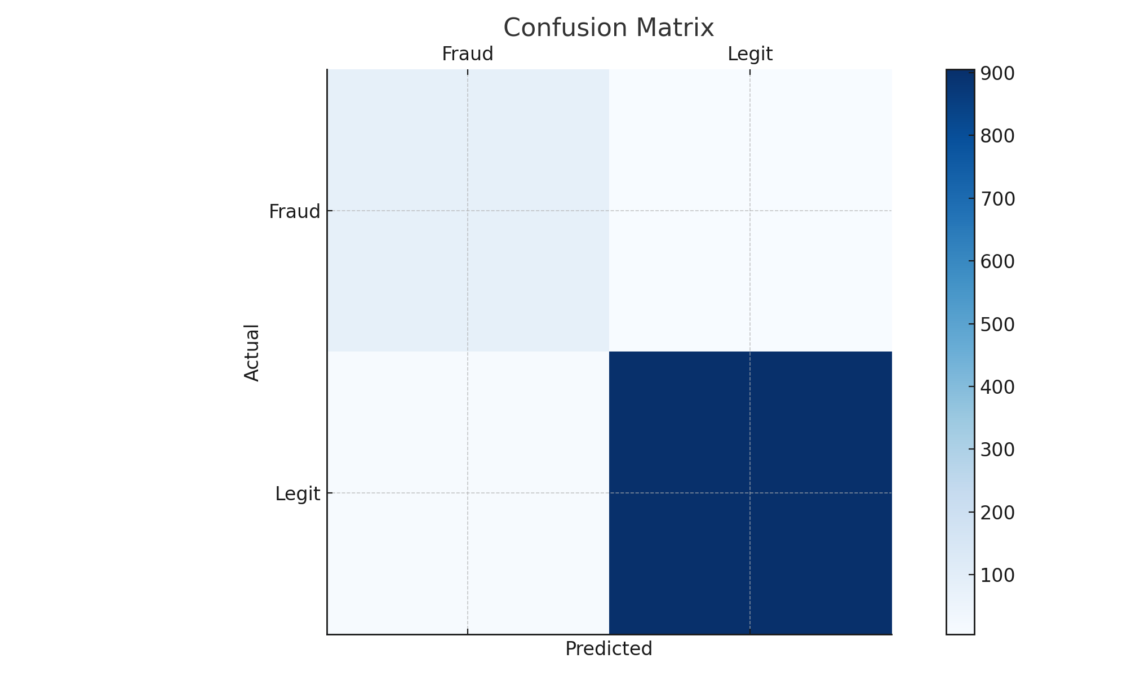
Confusion Matrix
Notes:
Confusion matrix shows that false negatives were minimized.

Slide 10
Deployment Overview
- Flask API - Render.com hosting - GitHub version control
Notes:
Built a Flask API, prepare my Procfile, app.py, saved my model in pickle file, prepared my requirements.txt file and deployed on Render for live model access.
At the end, the webpage shows Welcome to PayPal Fraud Detection API!.

Slide 11

Critical Reflection
Challenges:
Class imbalance
Overfitting risk
14 Failed Deployments
Solutions:
Class weighting
Cross-validation
Ensemble methods
Corrected and Tried 15 times.
Notes:
Key challenges were identified and mitigated with thoughtful techniques.

Slide 12

Methodology Evaluation
Strengths: • High accuracy and recall
Limitations: • Synthetic data • Overfitting possibility
Notes:
Model showed excellent metrics but synthetic data limited generalization.

Slide 13
Future Work
- Real-time pipeline integration - LSTM deep learning models - Model drift detection
Notes:
Future work will include advanced models and operational monitoring.

Slide 14
Conclusion
Full end-to-end analytics project.
Critical evaluation and deployment achieved
Notes:
This project demonstrated practical business analytics skills from start to deployment.

